Slide 1


Data Structures
ETCCBD201
Ms. Jyoti Yadav
Faculty
School of Engineering & Technology
K.R. Mangalam University
Unit 2 : Linear Data Structures

Slide 2

Unit-2 Linear Data Structures
SESSION 11 Arrays – 1D & 2D
SESSION 12 Static & Dynamic Arrays
SESSION 13 Linked Lists Types
SESSION 14 Linked List Operations
SESSION 15 Stack ADT & Operations
SESSION 16 Stack Applications
SESSION 17 Queue ADT
SESSION 18 Queue Applications
SESSION 19 BFS using Queue
SESSION 20 Revision (Unit–2)
Notes:
New Courses replaced with New Programmes

Slide 3
BFS using Queue
Session 19
Introduction to Graphs
Graph Traversal Techniques (BFS & DFS)
Breadth-First Search (BFS): Concept & Properties
BFS Algorithm (Steps)
BFS Pseudocode
BFS – Worked Example (Level-order traversal)
BFS Implementation using Queue
Applications of BFS
Check Your Understanding
Key Takeaways
References
Notes:
New Courses replaced with New Programmes

Slide 4
Learning Objectives
After this lecture, students will be able to:
Define a graph and identify its components
Differentiate between BFS and DFS
Explain BFS as a level-by-level traversal technique
Describe the role of a queue in BFS
Write the algorithm and pseudocode for BFS
Implement BFS using a queue
Trace BFS order for a given graph
Identify common applications of BFS
Notes:
New Courses replaced with New Programmes

Slide 5
Recapitulation (Queue Applications)
Queues implement FIFO for fair task processing.
Used in CPU scheduling, printer spooling, BFS, packet handling, customer service, and traffic control.
Circular queues optimize memory usage.
Priority queues serve high-priority tasks first.
Queue operations are efficient and essential for system design.
Notes:
New Courses replaced with New Programmes

Slide 6
Quick Quiz
Queue follows the __________ principle.
Circular queue overcomes the problem of __________ in linear queue.
A queue that serves higher priority elements first is called __________ queue.
Which operation inserts an element into a queue?
Which operation removes an element?
Name one OS application of queue.
Which queue connects last position to first?
Why is FIFO important in CPU scheduling?
Why is priority queue useful in operating systems?
Notes:
New Courses replaced with New Programmes

Slide 7
Quick Quiz (Answers)
FIFO
unused/vacant space
Priority
Enqueue
Dequeue
CPU scheduling/printer spooling
circular queue
Fairness
to handle urgent tasks first.
Notes:
New Courses replaced with New Programmes

Slide 8
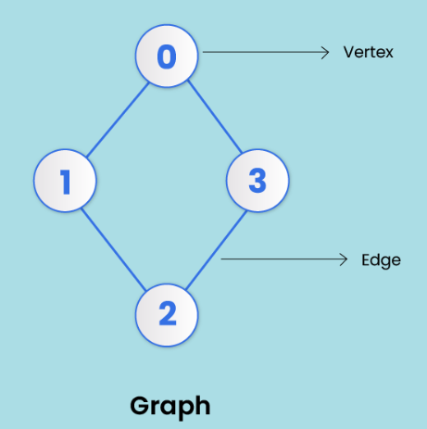
Introduction to Graphs
A graph is a non-linear data structure made up of nodes or vertices and edges.
The edges connect any two nodes in the graph, and the nodes are also known as vertices.
Notes:
New Courses replaced with New Programmes

Slide 9
Graph Traversal
Graph traversal is a method used to search nodes in a graph.
There are two traversal Techniques :
Breadth First Search
Depth First Search
Notes:
New Courses replaced with New Programmes

Slide 10
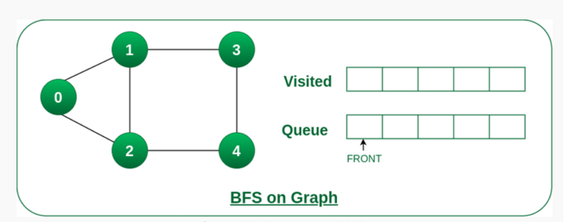
BFS (Breadth-First Search)
Breadth-First Search (BFS) is a graph traversal algorithm, where we start from a selected(source) node and traverse the graph level by level, by exploring the neighbor nodes at each level.
Notes:
New Courses replaced with New Programmes

Slide 11
Algorithm for BFS
Step 1 : Define a queue based on the number of nodes.
Step 2 : Start from any node, visit it, and add it to the queue.
Step 3 : Visit non-visited adjacent nodes in the queue.
Step 4 : Delete nodes without edges and not in the queue.
Step 5 : Empty the queue and form the spanning tree
Notes:
New Courses replaced with New Programmes

Slide 12
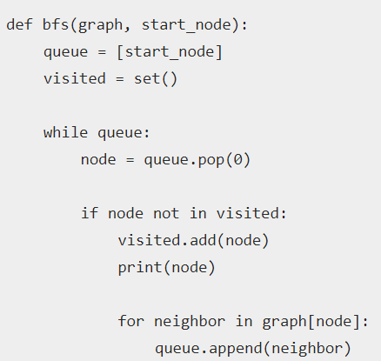
Algorithm for BFS: Pseudo code
Notes:
New Courses replaced with New Programmes

Slide 13
Example of BFS
BFS stands for __________ First Search.
BFS explores nodes __________ by __________.
The data structure used in BFS is a __________.
Queue follows the __________ principle.
Why is a queue suitable for BFS?
Which traversal technique explores deep before wide?
Notes:
New Courses replaced with New Programmes

Slide 14
QUICK CHECK
Breadth
level by level
Queue
FIFO
to process vertices in arrival order
DFS.
Notes:
New Courses replaced with New Programmes

Slide 15
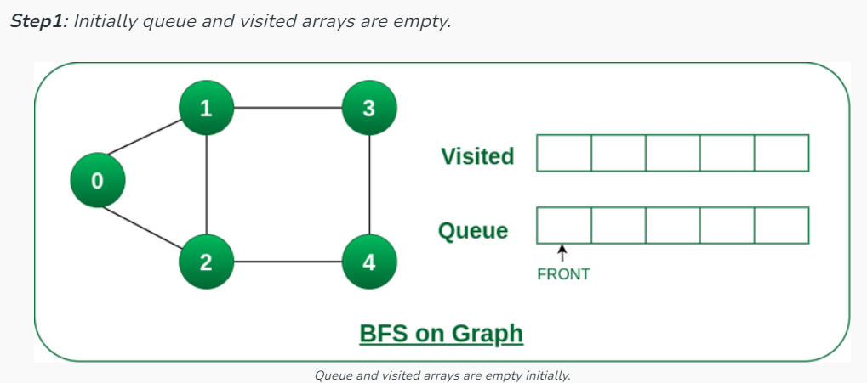
Example of BFS
Starting from the root, all the nodes at a particular level are visited first, and then the nodes of the next level are traversed till all the nodes are visited.
Notes:
New Courses replaced with New Programmes

Slide 16
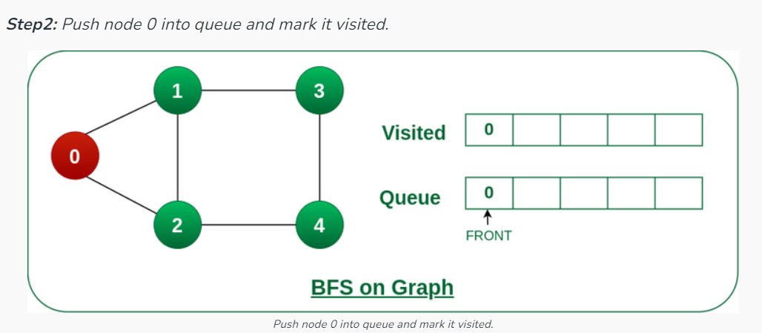
Example of BFS
Notes:
New Courses replaced with New Programmes

Slide 17
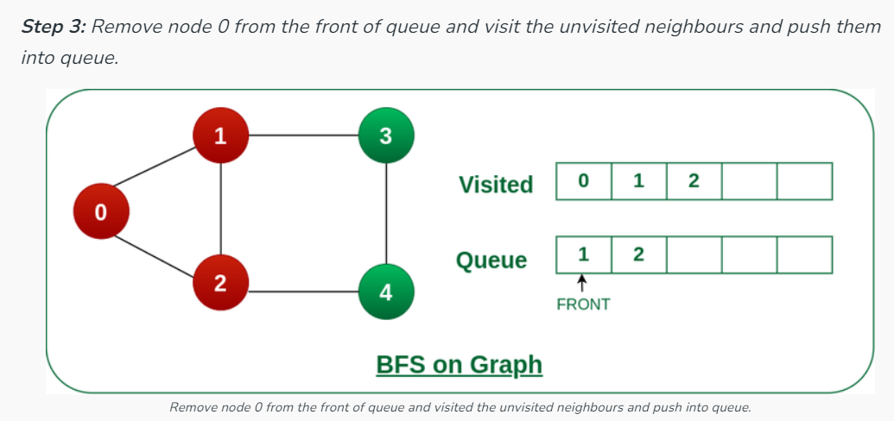
Example of BFS
Notes:
New Courses replaced with New Programmes

Slide 18
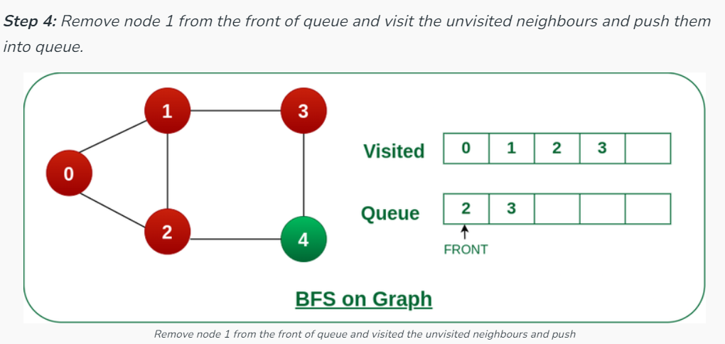
Example of BFS
Notes:
New Courses replaced with New Programmes

Slide 19
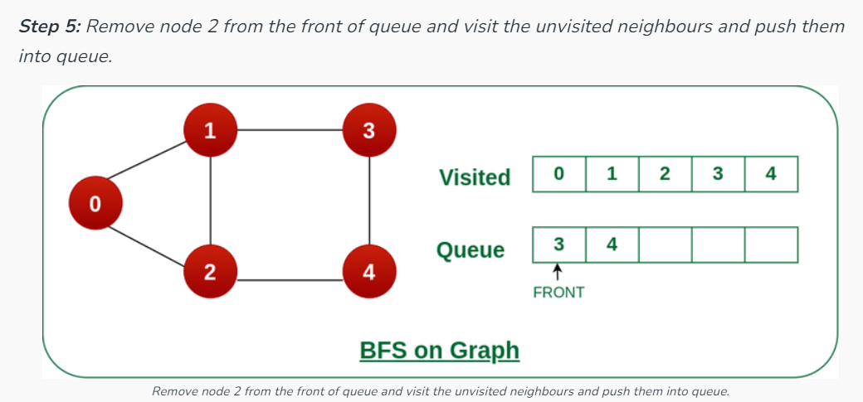
Example of BFS
Notes:
New Courses replaced with New Programmes

Slide 20
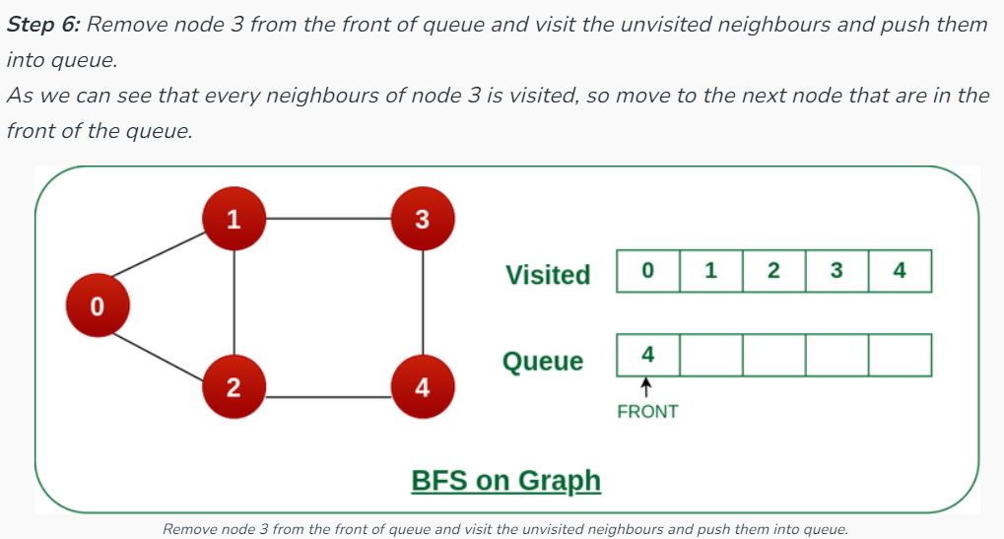
Example of BFS
Notes:
New Courses replaced with New Programmes

Slide 21
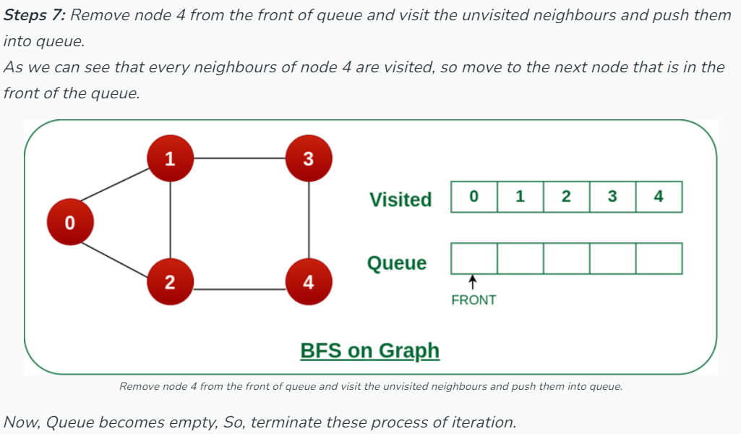
Example of BFS
Notes:
New Courses replaced with New Programmes

Slide 22

Implementing BFS traversal in Graph
BFS Traversal (PYTHON)
from collections import deque
def bfs(graph, start):
visited = set() # to keep track of visited nodes
queue = deque() # queue for BFS
visited.add(start)
queue.append(start)
print("BFS Traversal:", end=" ")

Slide 23
Implementing BFS traversal in Graph
BFS Traversal (PYTHON)
while queue:
node = queue.popleft() # dequeue
print(node, end=" ")
for neighbor in graph[node]:
if neighbor not in visited:
visited.add(neighbor)
queue.append(neighbor)

Slide 24
Implementing BFS traversal in Graph
BFS Traversal (PYTHON)
# Example graph (adjacency list)
graph = {
'A': ['B', 'C'],
'B': ['A', 'D', 'E'],
'C': ['A', 'F'],
'D': ['B'],
'E': ['B', 'F'],
'F': ['C', 'E']
}
# Call BFS
bfs(graph, 'A')

Slide 25
Implementing BFS traversal in Graph
BFS Traversal
void BFS(int startVertex) {
vector<bool> visited(numVertices, false);
queue<int> q;
visited[startVertex] = true;
q.push(startVertex);
cout << "BFS Traversal starting from vertex " << startVertex << ": ";

Slide 26
Implementing BFS traversal in Graph
BFS Traversal
while (!q.empty()) {
int vertex = q.front();
q.pop();
cout << vertex << " ";
for (int adjVertex : adjList[vertex]) {
if (!visited[adjVertex]) {
visited[adjVertex] = true;
q.push(adjVertex);
}
}
}
cout << endl;
}
Access the Complete Code here :https://onlinegdb.com/m5if5mL4_

Slide 27
QUICK CHECK
How many times is a node visited in BFS?
What is enqueued first: the start node or its neighbors?
Which operation removes a vertex from the queue?
State one application of BFS.
Notes:
New Courses replaced with New Programmes

Slide 28
QUICK CHECK (ANSWERS)
Once
start node
Dequeue
shortest path / bipartite check / level order traversal.
Notes:
New Courses replaced with New Programmes

Slide 29
BFS APPLICATIONS
Shortest Path in Unweighted Graphs: Finds the minimum number of edges between two vertices.
Level Order Traversal of Trees: Visits nodes level by level in binary trees and general trees.
Finding Connected Components: Checks which vertices are reachable from a given vertex.
Bipartite Graph Checking: Determines whether a graph can be colored using two colors.
Web Crawling: Used to traverse web pages level by level from a starting page.
Notes:
New Courses replaced with New Programmes

Slide 30
BFS APPLICATIONS
GPS and Map Navigation (Unweighted paths): Determines shortest routes when all edges have equal weight.
Network Broadcasting: Used to send data to all nodes in minimum time steps.
Social Network Analysis: Finds people at a certain “distance” (friends, friends of friends).
Puzzle Solving & Game AI: Used in problems like maze solving and minimum-move puzzles.
Garbage Collection Algorithms: Marks reachable memory blocks in memory management.
Notes:
New Courses replaced with New Programmes

Slide 31
Test Your Knowledge
Q1 A person wants to visit some places. He starts from a vertex and then wants to visit every place connected to this vertex and so on. What algorithm he should use? a) Depth First Search b) Breadth First Search c) Trim’s algorithm d) Kruskal’s algorithm
Answer (B)
Q2 Which of the following is not an application of Breadth First Search? a) Finding shortest path between two nodes b) Finding bipartiteness of a graph c) GPS navigation system d) Path Finding
Answer (D)
Notes:
New Courses replaced with New Programmes

Slide 32
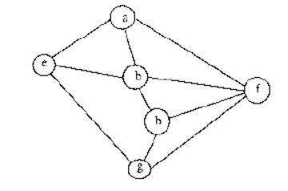
Test Your Knowledge
Q3 In BFS, how many times a node is visited? a) Once b) Twice c) Equivalent to number of indegree of the node d) Thrice
Answer (C)
Q4 Consider the following graph, Among the following sequences:Which is breadth first traversals of the above graph?
A) a → e → b → f → g → h B) a → b → e → h → g → f C) a → f → b → e → h → g D) a → e → g → b → h → f
Answer (A)
Notes:
New Courses replaced with New Programmes

Slide 33
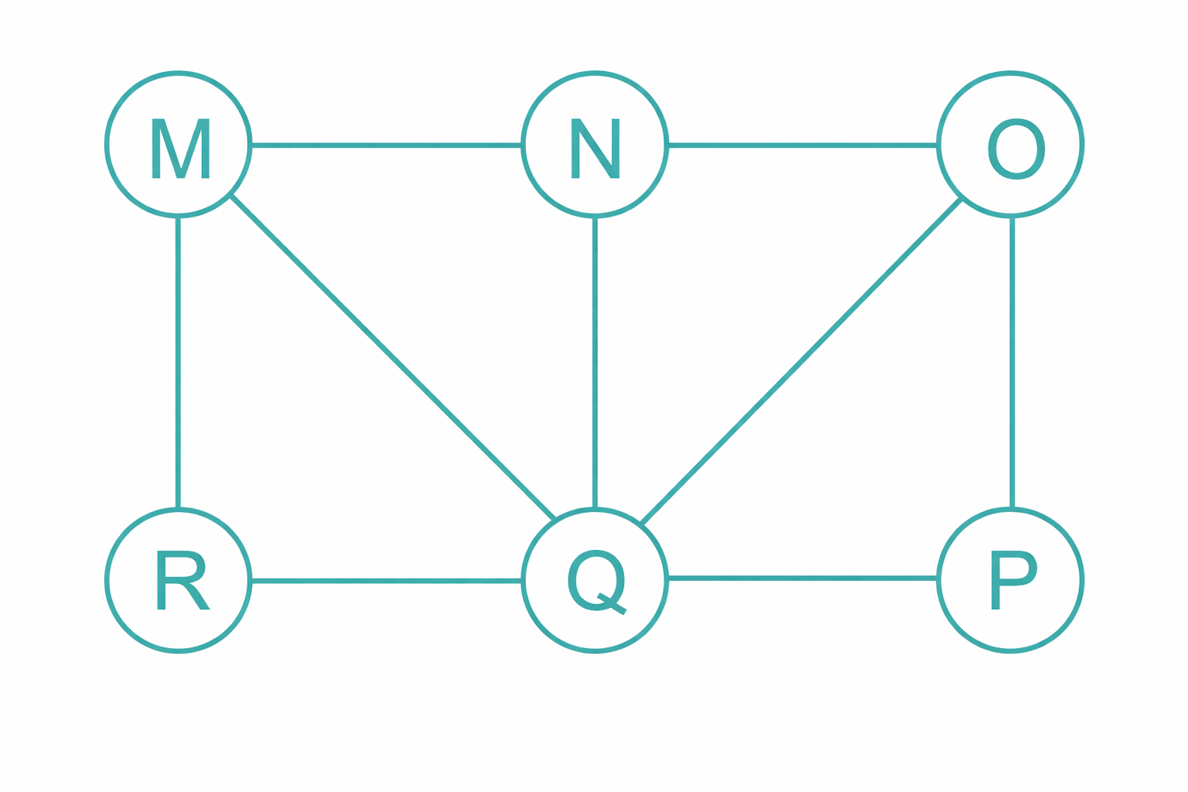
Test Your Knowledge
Q5. Perform Breadth-First Search (BFS) traversal of the given graph starting from vertex M. Write the traversal order.
Answer:
BFS order:
M → N → Q → R → O → P
(Level-wise explanation)
Level 0: M
Level 1: N, Q, R
Level 2: O, P
Q6. What is the order of nodes in the queue after visiting node M and then node N?
Answer:
Queue after visiting:
M → enqueue (N, Q, R)
Visit N → enqueue O
Final queue:
Q, R, O
Notes:
New Courses replaced with New Programmes

Slide 34
Test Your Knowledge
Q7. How many levels are formed in the BFS traversal starting from M?
Answer:
3 levels
(Levels: {M}, {N,Q,R}, {O,P})
Q8. Which nodes are visited immediately before node P in BFS order?
Answer:
O
(Traversal: M → N → Q → R → O → P)
Notes:
New Courses replaced with New Programmes

Slide 35
KEY TAKEAWAYS
BFS is a graph traversal algorithm that visits vertices level by level.
It uses a queue (FIFO) to manage the traversal order.
Each vertex is visited once and marked to avoid repetition.
BFS is ideal for shortest path (unweighted graphs), bipartite checking, and level-order traversal.
Time Complexity: O(V + E)
Space Complexity: O(V) (for queue + visited array)
Notes:
New Courses replaced with New Programmes

Slide 36
References
https://www.boardinfinity.com/blog/graphs-in-data-structure/.
https://www.geeksforgeeks.org/what-is-graph-data-structure/
https://www.tutorialspoint.com/data_structures_algorithms/graph_data_structure.html.
https://www.simplilearn.com/tutorials/data-structure-tutorial/graphs-in-data-structure
https://www.geeksforgeeks.org/applications-of-graph-data-structure/
https://www.upgrad.com/blog/graphs-in-data-structure/
https://www.youtube.com/watch?v=4IZ80K72OXo
Notes:
New Courses replaced with New Programmes

Slide 37
THANK YOU

